Slide 1


Slide 2

Background
Retail Operations Security Services (ROSS) was established in 2001 to provide a professional and tailor-made security solution to various Industries.
Shareholding is representative of South Africa’s demographics. Level 4 BBBEE contributor.
OUR ONGOING COMMITMENT
Deliver to our clients

Slide 3
Our Mission
Professionalism
Incomparable Service
Dedicated & Knowledgeable Management Team
Commitment
Our guarantee to you

Slide 4

Our Principles
Partnering with our clients
Be proactive rather than reactive.
Upholding your company image
Providing your staff and customers with peace of mind.
Providing cost-effective solutions.

Slide 5
Our Values
Discipline
Professionalism
Integrity
Responsibility
Dedication
Respect
Teamwork

Slide 6
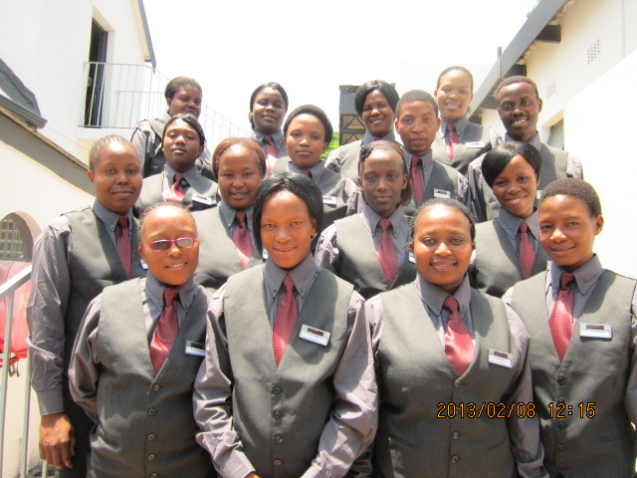
Our Focus
Our focus is on customer service rather than the traditional military style guards.
Our risk officers compliment our customers image and are perceived by visitors as part of the company staff.
We at ROSS made it our objective to provide a very unique service for industries in South Africa.

Slide 7
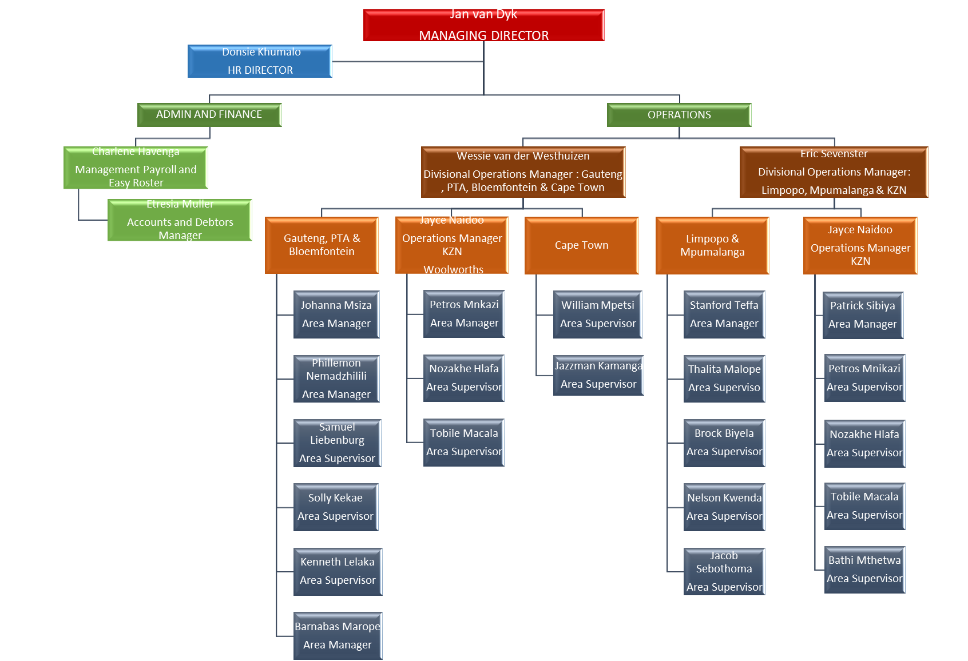
Organogram

Slide 8

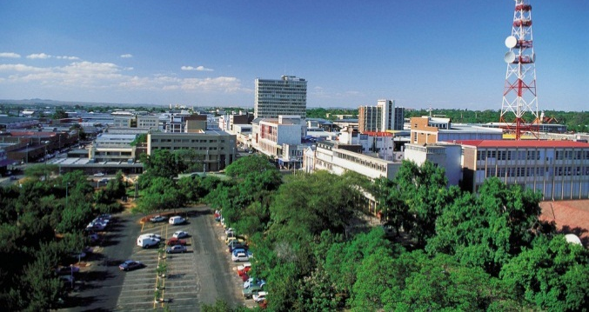
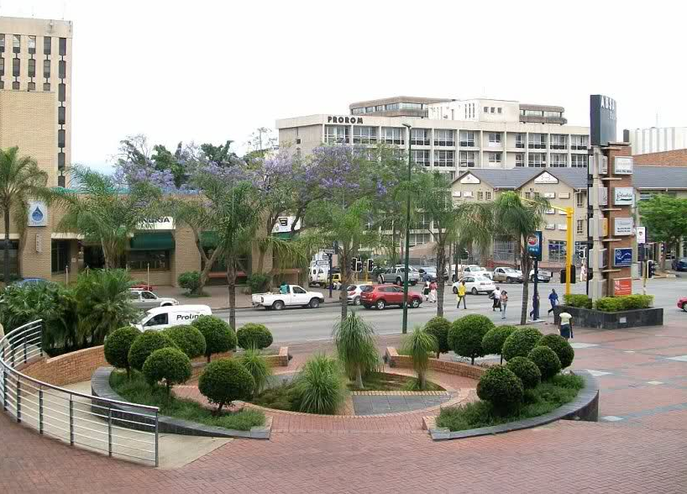

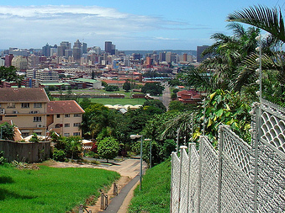
Geographical Areas Serviced
Gauteng North
Gauteng East
Gauteng South
Gauteng West
Mpumalanga
Freestate
Limpopo Province
North-West Province
Western Cape
Eastern Cape
Kwazulu-Natal
KZN Midlands

Slide 9














Our Clients
Kiepersol Estate Equestria

Slide 10
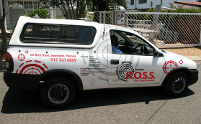
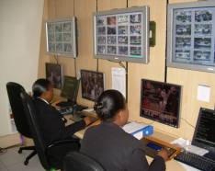
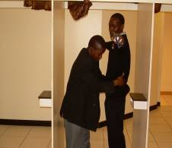
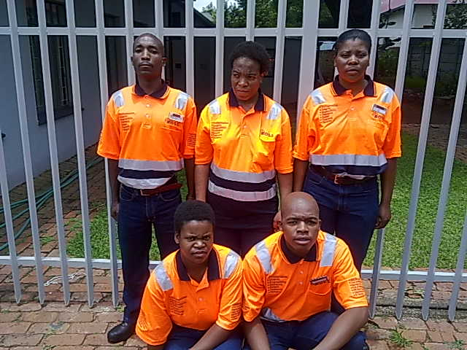
SERVICES - Guarding
Access control
Patrolling
System checkers
Control Room Operators
Front Door Greeters
Video Alarm Monitoring
Point of Sale Supervision
Day to Day Auditors
Undercover Operatives

Slide 11
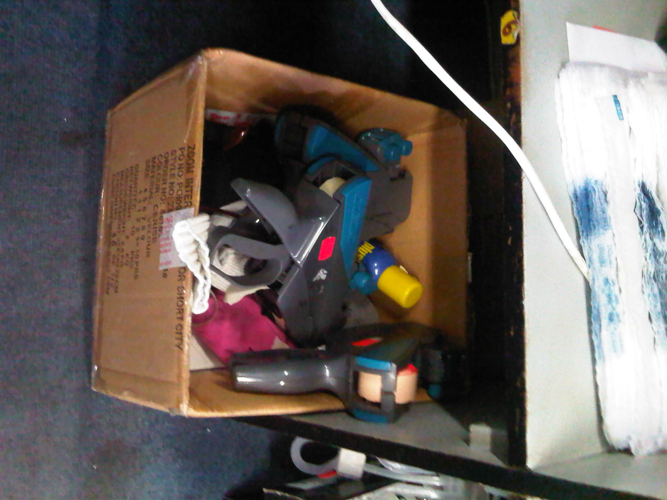
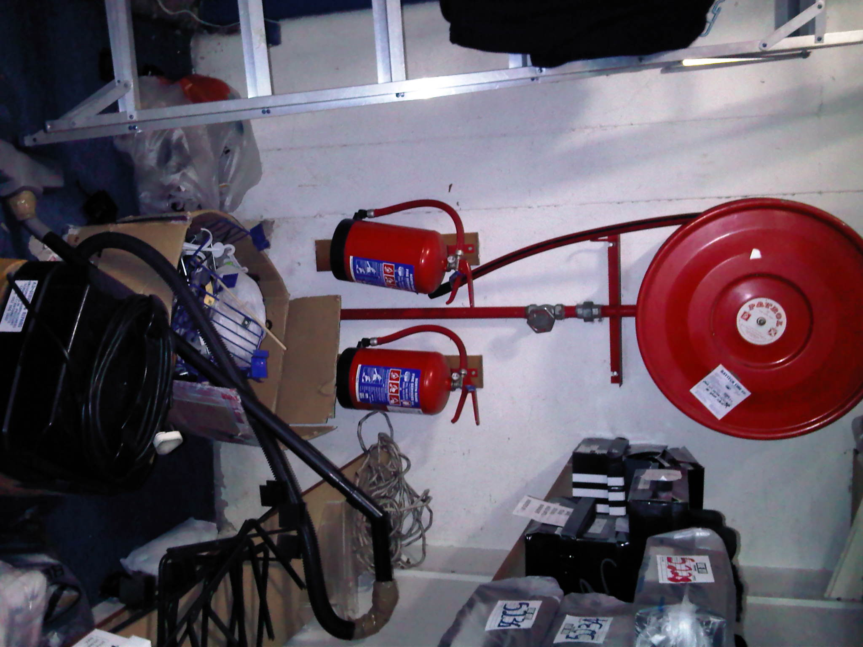
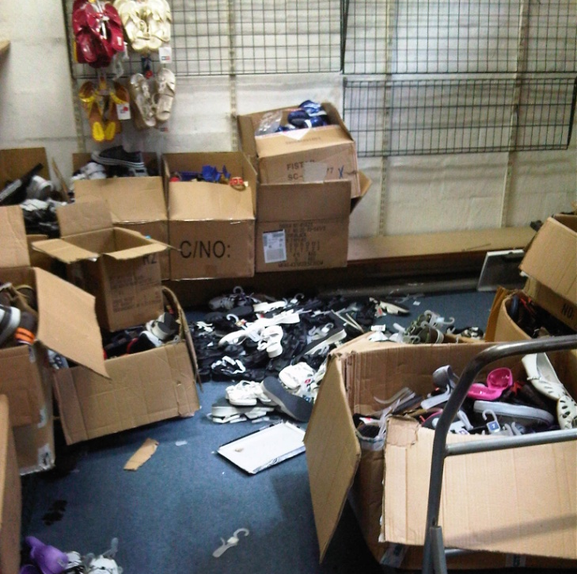
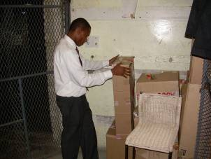
SERVICES - Investigations
Special trained managers do all the investigations
A full report gets drawn up and submitted to the clients head office.
Investigations into different areas of activity also utilizing polygraph testing and agents
Covert’ camera and agent operations
Risk assessment surveys and Stock loss action plans;

Slide 12
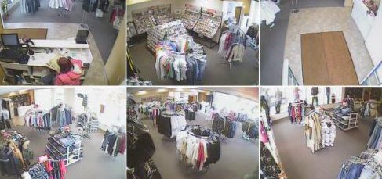
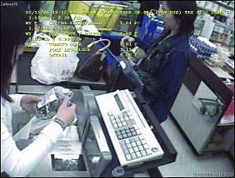
SERVICES – Technical Solutions
Electronic Systems
Perimeter security options with Alarm systems i.e. Electric Fences (and palisade), various Alarm Keypad- and Passive options;
CCTV options with monitoring, on-site and remotely;

Slide 13
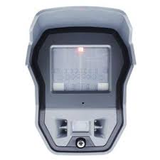
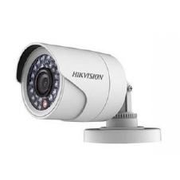
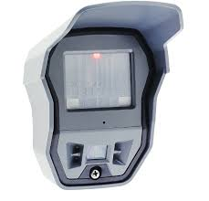
Technology
The use of site surveillance is becoming increasingly popular as a method to manage and measure staff activity. Off-site surveillance also greatly reduces the threat of collusion and intimidation.
An integrated solution would typically comprise of various technology products i.e CCTV, on and off site surveillance, alarm monitoring and access/egress systems.

Slide 14
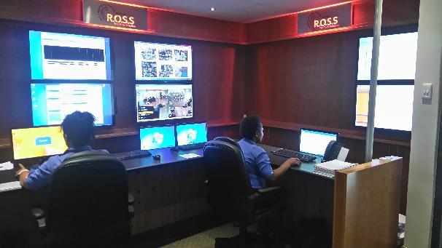
Monitoring
ROSS has teamed up with expert suppliers.
We have a state of the art control room with the latest technology and products

Slide 15
SERVICES – Stock and Site Auditing
Weekly visits, audits and Risk Assessments.
Report to management on each visit
Site-specific Site Audit service performed by ROSS Audit Team Manager providing an in-depth detailed report on all areas of operation, processes, procedures and staff per site;
Specialist System Checkers on an Integrated Process Management model;
Aimed at Warehouses, Distribution center’s, and Retail Stores in the Retail Sector

Slide 16
Staff - Recruitment
Application form and full CV reviewed
Pre-employment screening test
Interview
Candidates selected for training
Reference checks
Pre-employment polygraph test;
ROSS specialist training
Deployment to Site

Slide 17

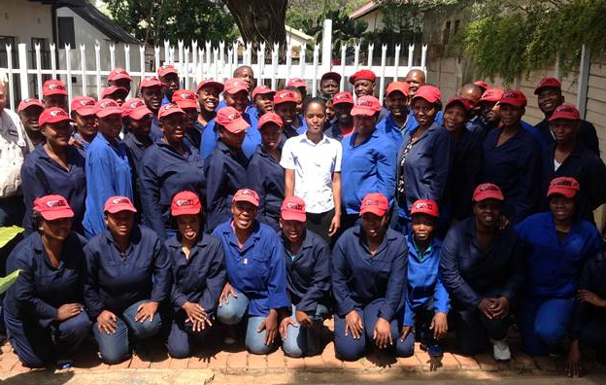
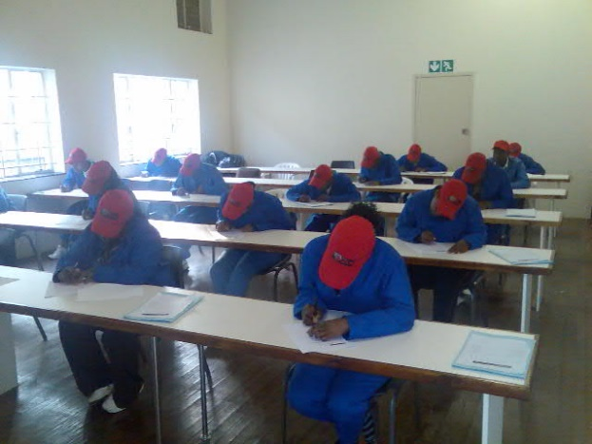
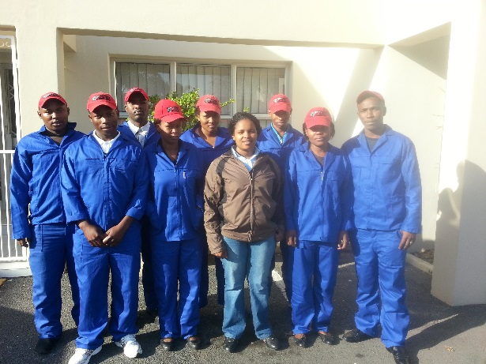
Staff - Training
Fully equipped classrooms in Pretoria(2), Cape Town(1), Durban(1) and Mpumalanga(1)
Registered and accredited with PSIRA,
Qualified to train Grade E-A and Retail
Practical site training after completion of theoretical training
Customised training - We look at customer requirements before a course gets drawn up or the officers get trained.
Site specific training, done on site by our Area Manager & Training Manager at random

Slide 18
Staff - Remuneration
On Top of the Normal basic wage, ROSS also pays their staff through specified allowances
Normal basic wage
Supervisory Allowance
Travel Allowance
Cell Phone Allowance
Laundry Allowance

Slide 19
Staff – Awards/Motivations
Site of the Month Award
Directors award
Our Top performer of the Month receive a R500 bonus award and Certificate acknowledging the achievement.
Our Top site of the Month receive a floating trophy, and certificates acknowledging the site achievement for the month
Awarded by director on ad-hoc basis for exceptional contribution by any officer
Employee of the Month Award
Best dressed officer
Awarded to officer for continuously dressing and behaving according to the strict dress code and code of conduct

Slide 20
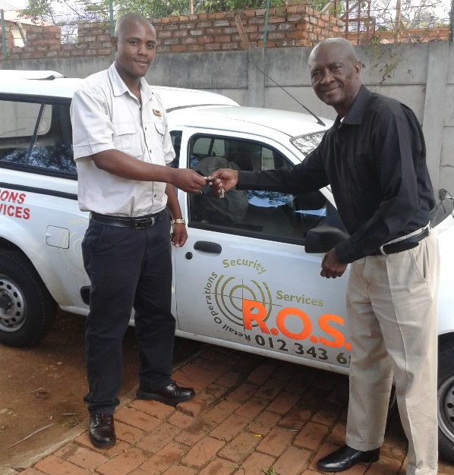
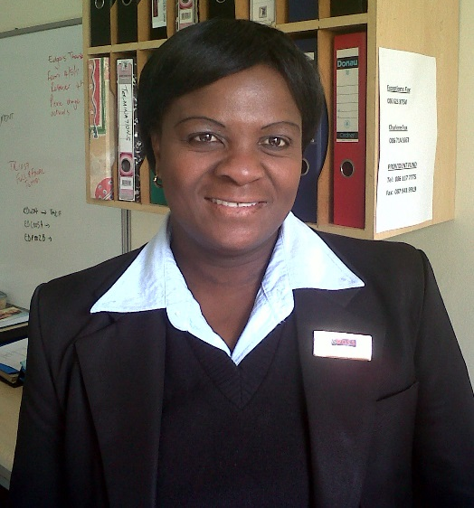
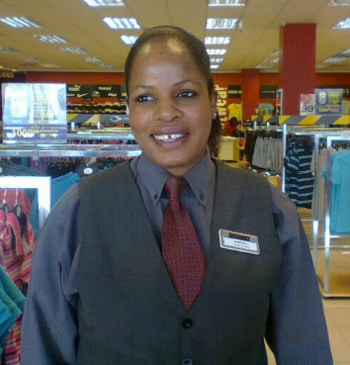
Staff - Development
Officer
Site Supervisor
Area Manager
Manager
Area Supervisor
R.O.S.S works to IDENTIFY potential
and GROW people

Slide 21

Quality Controls – Site Visitation
Quality Controls – Site Visitation
A structured schedule ensuring at least
One Area Manager visit per site per week.
Operation manager review Scorings and visits any site where problems are identified
Operation Executive visits to areas, and ensures that all problems are addressed

Slide 22

Quality Controls – Reports
Structured risk model report ensuring that all risk areas are
  Identified
  Evaluated
  Findings communicated to Store Management for prioritization
  and action.
Front Door / Receiving / Floor / Podiums / Stock Room / High Risk

Slide 23

CERTIFICATES / Accreditation
Company Registration PSIRA
Company Training Accreditation
South African Qualifications Authority (SAQA)
BEE Accreditation - Level 4

Slide 24
Contact Details
Jan van Dyk
Managing Director
Office 012 343 6869
Cell 082 445 4104
Email jan@rosss.co.za
Donsie Khumalo
Director Human Resources
Office 012 343 6869
Cell 083 292 3644
Email donsie@gpretail.co.za

